Slide 1
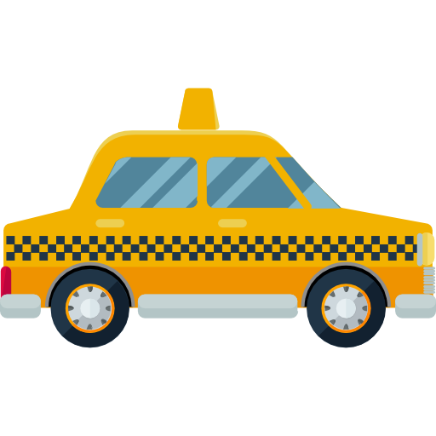
KLH Cab Share
Advanced Object Oriented Programming

Slide 2
TEAM MEMBERS
2110030316-B.Sai Kishore
2110030329-B.Ashrith
2110030342-P.Bhargavraj

Slide 3
Introduction
A cab system that accepts real-time requests from passengers.
Schedules taxis to pick them up.
TIME, CAPACITY and MONETARY constraints are kept in mind.

Slide 4
How it works
Passenger submits request
Cloud searches for taxi which minimizes travel distance increase
Existing passengers asked if they want to pick up the passenger
Passenger evaluates time increase / cost decrease tradeoff
Unanimous agreement reached

Slide 5
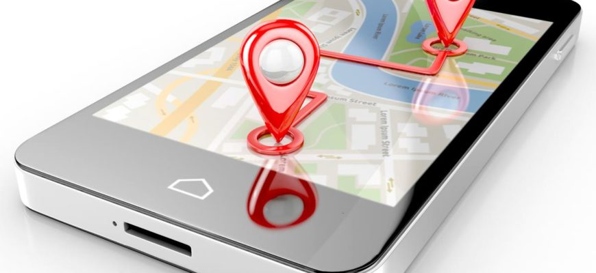
ADVANTAGES
Reduces Taxi fare of passengers
Increases income of Taxi Drivers
Saves a ton of fuel!
Lesser traffic!

Slide 6
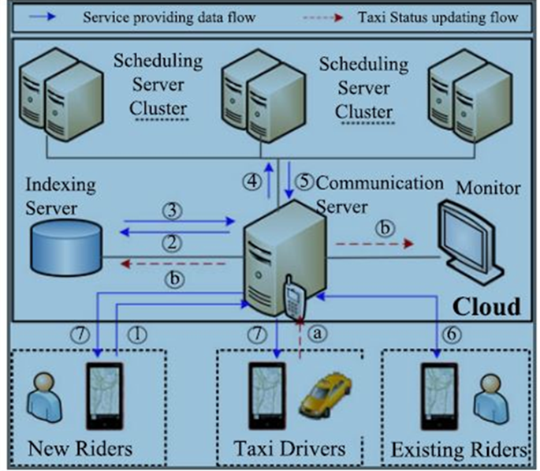
System architecture - overview
The cloud consists of multiple servers for different purposes and a monitor to oversee the running of the system.
Taxi drivers and passengers use the same smartphone App to interact with the system, but are provided with different user interfaces.
A taxi automatically reports its location to the cloud via the mobile App when
(i) the taxi establishes the connection with the system,
(ii) a rider gets on and off a taxi, or
(iii) at a frequency (e.g., every 20 seconds) while a taxi is connected to the system.

Slide 7
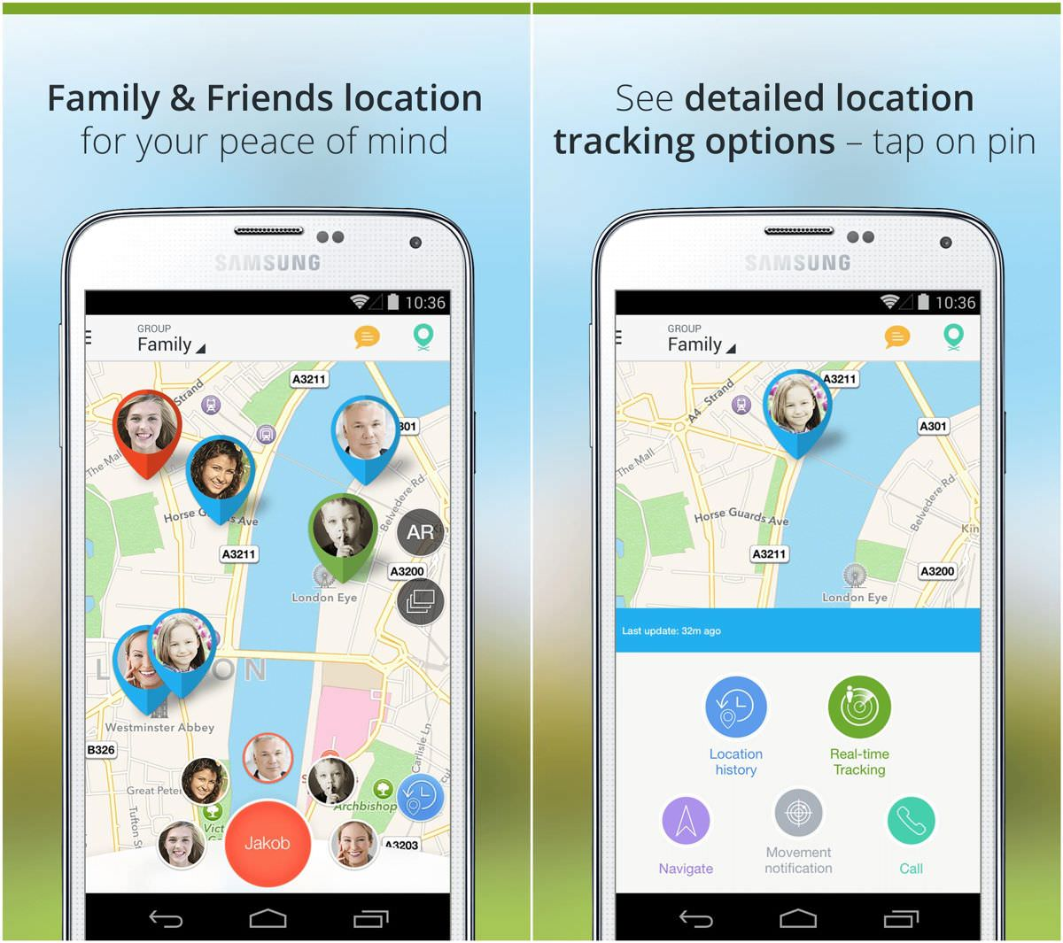
Real time flow
Passenger submits new ride request Q to Communication Server
Communication server sends it to the Indexing Server to search for candidate taxis SV that are likely to satisfy Q
The Indexing Server returns SV to the Communication Server
Communication Server sends ride request Q and the received candidate taxi set SV to the Scheduling Server Cluster
Scheduling Cluster returns the taxi with the lowest increase in travel distance
Each passenger is asked whether they would like to accept the request

Slide 8
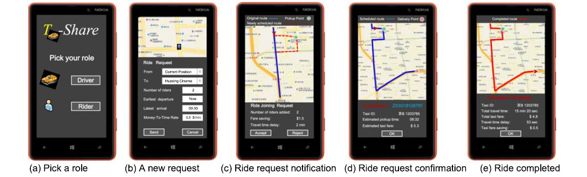
Mobile app interface

Slide 9
Conclusion
This paper proposed and developed a mobile-cloud
based real-time taxi-sharing system.
Presented detail interactions between end users
(i.e. taxi riders and drivers) and the Cloud.
Validated our system based on a GPS trajectory data set generated
by 33,000 taxis over three months, in which over 10 million ride
requests were extracted.
This system can enhance the delivery capability of taxis in a city so as to satisfy the commute of more people.
The system saves the total travel distance of taxis when delivering passengers.
The system can also save the taxi fare for each individual rider while the profit of taxi drivers does not decrease compared with the case where no taxi-sharing is conducted.

Slide 10

Thank You

